Slide 1

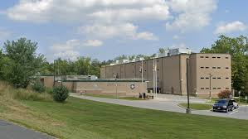

Immigration and Customs Enforcement
287(g) Program
Sheriff Jeffrey R. Gahler
Harford County Sheriff’s Office

Slide 2
287(g) Steering Committee Mission Statement
Improve program oversight and direction.
Identify issues and concerns regarding immigration enforcement activities.
Maintain transparency.
Offer the community opportunities to communicate community-level perspectives.

Slide 3
287(g) Steering Committee Vision Statement
Create safer communities and improve national security by enhancing ICE’s ability to identify and remove criminal aliens by gaining an independent, community-level perspective on 287(g) operations.

Slide 4
287(g) Program
Section 287(g) of the Immigration and Nationality Act was added in 1996 to authorize the Attorney General to delegate federal immigration authorities to state and local law enforcement officers. This was later transferred to the Secretary of Homeland Security.

Slide 5
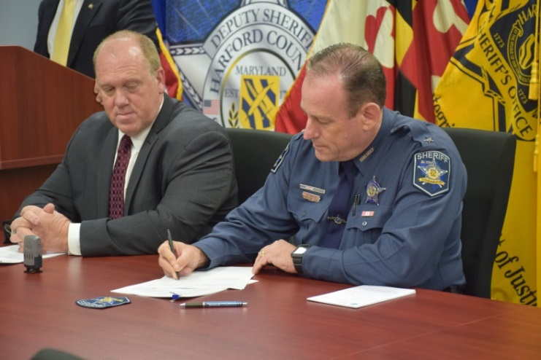
Harford County 287(g) Program Implementation Date
Memorandum of Agreement signed on October 26, 2016 and is available at www.ICE.gov
Currently there are 6 Correctional Deputies trained and certified by I.C.E. with the authority to enforce immigration laws under section 287 of the Immigration Nationality Act
The Harford County 287(g) program went operational May 24, 2017.

Slide 6
Harford County 287(g) Program Oversight
The program has a full time I.C.E. Program Manager that reviews all detainers lodged, cases and related documentation.
The I.C.E. Office of Professional Responsibility conducts routine inspections of the program every 2-years.

Slide 7
Harford County 287(g) Program Costs To The County
The following was provided by I.C.E. at no cost to Harford County.
    Training
    Equipment
    Oversight
No full time county staff are dedicated solely to the program.

Slide 8
Training Requirements
ICE provides a four-week basic training program and a one-week refresher training program (completed every two years) conducted by certified instructors at the Federal Law Enforcement Training Center (FLETC) ICE Academy (ICEA) in Charleston, SC. Immigration Law, Interviewing Skills, Cross-cultural communication and the Avoidance of Racial Profiling are a few mandatory training courses that every Designated Immigration Officer (DIO) must successfully complete before becoming certified by ICE.
In addition, Designated Immigration Officers (DIOs) annually complete additional training courses related to immigration enforcement activities.
DIOs receive the same training in Immigration and Nationality Law as ICE officers. All training, to include transportation, lodging, and meals is provided and paid for by ICE.

Slide 9
Immigration Enforcement Screening
All arrestees and facility intakes entering the Detention Center
are screened.
287(g) trained Correctional Deputy’s authority resides within the confines of the Harford County Detention Center.
No “on the street” law enforcement officers are trained or authorized to conduct immigration enforcement.

Slide 10
Harford County 287 (g) Program 2022 Statistics
In 2022, the 287 (g) Unit screened
2,902 new arrestees & 17 sentenced inmates
for the total of:
2,919 Screened

Slide 11
Harford County 287 (g) Program 2022 Statistics cont.
2,919 Screened
49 Different countries were recorded.
176 Foreign born individuals were encountered
43 Detainers were lodged
154 Males and 22 Females were recorded
139 Misdemeanor charges and 37 Felony charges
100 Provided a Harford County address as their residence
Majority of arrestees were between 18-29 years of age
Assault 1st & 2nd Degree, DUI and Failure to Appear were the most common charges.

Slide 12

Number of Encounters from the
49 Countries
Afghanistan (4) Ghana (10) Mongolia (1) Togo (1)
Armenia (1) Guatemala (12) Netherlands (1) Venezuela (1)
Aruba (2) Guyana (1) Nepal (2) Vietnam (1)
Cameroon (1) Haiti (3) New Guinea (1) Yemen (1)
Canada (1) Honduras (23) Nicaragua (1)
Central African Republic (1) India (8) Nigeria (8)
Chile (1) Iraq (1) Pakistan (4)
China (1) Italy (1) Peru (1)
Congo (2) Ivory Coast (2) Philippines (1)
Dominican Republic (3) Jamacia (4) Poland (1)
Ecuador (1) Japan (2) Romania (2)
El Salvador (18) Kenya (1) Russia (5)
Eritrea (2) Laos (1) Sierra Leone (1)
Ethiopia (2) Liberia (7) Tajikistan (1)
Germany (7) Mexico (16) Trinidad & Tobago (3)

Slide 13
287(g) Complaint Process
Complaints regarding the 287(g) program will be accepted from any source to include law enforcement agencies (LEAs), participating LEA personnel, arrestees, and the public. To report a 287(g) complaint please contact one of the following Department of Homeland Security (DHS) components:
Telephonically to the DHS Office of the Inspector General (DHS OIG). Toll free number 1-800-323-8603; or
Telephonically to the ICE Office of Professional Responsibility (OPR) at the Joint Intake Center (JIC) in Washington, D.C. Toll-free number 1-877-246-8253, or email Joint.Intake@dhs.gov; or

Slide 14
Complaint Process cont.
Via mail as follows:
Department of Homeland Security
Immigration and Customs Enforcement
Office of Professional Responsibility
P.O. Box 14475
Pennsylvania Avenue NW
Washington D.C. 20044
A copy of the complaint will be forwarded to the DHS Office for Civil Rights and Civil Liberties (CRCL) Review and Compliance.

Slide 15

Written by : HCSO 287 (g) Unit Commander - Lt. Yvonne Chester and ICE 287 (g) Program Manager -Benjamin Buchta

