Slide 1

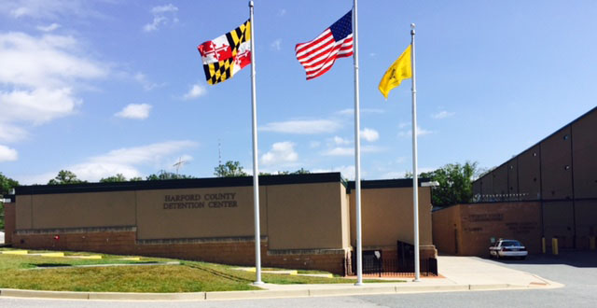

Immigration and Customs Enforcement
287(g) Program
Sheriff Jeffrey R. Gahler
Harford County Sheriff’s Office

Slide 2
287(g) Steering Committee Mission Statement
Improve program oversight and direction.
Identify issues and concerns regarding immigration enforcement activities.
Maintain transparency.
Offer the community opportunities to communicate community-level perspectives.

Slide 3
287(g) Steering Committee Vision Statement
Create safer communities and improve national security by enhancing ICE’s ability to identify and remove criminal aliens by gaining an independent, community-level perspective on 287(g) operations.

Slide 4
287(g) Program
Section 287(g) of the Immigration and Nationality Act was added in 1996 to authorize the Attorney General to delegate federal immigration authorities to state and local law enforcement officers. This was later transferred to the Secretary of Homeland Security.

Slide 5
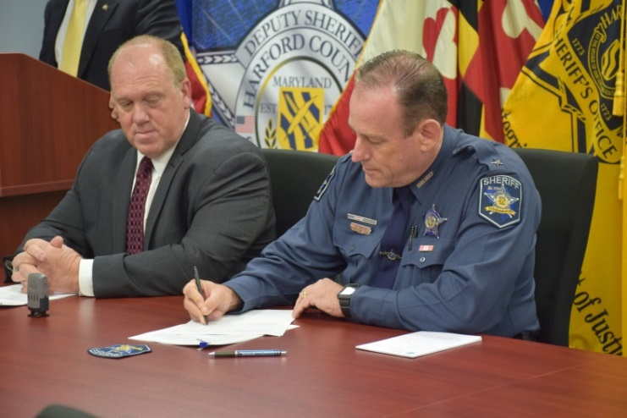
Harford County 287(g) Program Implementation Date
Memorandum of Agreement signed on October 26, 2016 and is available at www.ICE.gov
Currently there are 11 Correctional Deputies trained and certified by I.C.E. with the authority to enforce immigration laws under section 287 of the Immigration Nationality Act
The Harford County 287(g) program went operational May 24, 2017.

Slide 6
Harford County 287(g) Program Oversight
The program has a full time I.C.E. Program Manager that reviews all detainers lodged, cases and related documentation.
The I.C.E. Office of Professional Responsibility conducts routine inspections of the program every 2-years.

Slide 7
Harford County 287(g) Program Costs To The County
The following was provided by I.C.E. at no cost to Harford County.
    Training
    Equipment
    Oversight
No full time county staff are dedicated solely to the program.

Slide 8
Training Requirements
ICE provides a four-week basic training program and a one-week refresher training program (completed every two years) conducted by certified instructors at the Federal Law Enforcement Training Center (FLETC) ICE Academy (ICEA) in Charleston, SC. Cross-cultural communication and the avoidance of racial profiling is required training.
In addition, Designated Immigration Officers (DIOs) annually complete additional training courses related to immigration enforcement activities.
DIOs receive the same training in Immigration and Nationality Law as ICE officers. All training, to include transportation, lodging, and meals is provided and paid for by ICE.

Slide 9
I.C.E. Priorities Set Forth By Executive Order on January 25, 2017
Convicted of or charged with any criminal offense.
Committed an act which constitute a chargeable criminal offense.
Engaged in fraud or willful misrepresentation in connection with any official matter before a government agency.

Slide 10
I.C.E. Priorities Set Forth By Executive Order on January 25, 2017
Have abused any program related to the receipt of public benefits.
Are subject to a final order of removal but have not complied with their legal obligation(s).
In the judgement of an I.C.E. official, poses a risk to public safety or national security.

Slide 11
Immigration Enforcement Screening
100% of all arrestees and facility intakes entering the Detention Center are screened.
287(g) trained Correctional Deputy’s authority resides within the confines of the Harford County Detention Center.
No “on the street” law enforcement officers are trained or authorized to conduct immigration enforcement.

Slide 12
Harford County 287 (g) Program 2018 Statistics
In 2018, the 287 (g) Unit screened
3,876 new arrestees & 934 sentenced inmates
for the total of:
4,810 screened

Slide 13
Harford County 287 (g) Program 2018 Statistics cont.
4,810
46 Different countries were recorded.
161 Foreign born individuals were encountered
38 Detainers were lodged
129 Males and 32 Females were recorded
141 Misdemeanor charges and 20 Felony charges
106 Provided a Harford County address as their residence
Majority of arrestees were between 30-39 years of age
Assault, DUI/DWI and FTA were the most common charges.

Slide 14
2018 List of Countries
Germany (13) Mozambique (1)
Grenada (2) Netherlands (1)
Guatemala (9) Nicaragua (2)
Guyana (3) Nigeria (6)
Haiti (4) Philippines (4)
Honduras (9) Romania (1)
Iran (1) Russia (5)
Ireland (1) Serbia (1)
Italy (2) Sierra Leone (5)
Jamaica (8) Somalia (1)
Jordan (1) South Korea (3)
Kenya (3) Trinidad & Tobago (1)
Korea (3) Turkey (1)
Liberia (5) United Kingdom (3)
Mexico (17) Vietnam (4)
Yemen (1)
Albania (1)
Antigua (1)
Bangladesh (1)
Bolivia (1)
Cameroon (2)
Chile (1)
China (3)
Colombia (2)
Croatia (2)
Cuba (2)
Cyprus (2)
Dom. Republic (5)
Ecuador (2)
El Salvador (13)
Eritrea (1)

Slide 15
287(g) Complaint Process
Complaints regarding the 287(g) program will be accepted from any source to include law enforcement agencies (LEAs), participating LEA personnel, arrestees, and the public. To report a 287(g) complaint please contact one of the following Department of Homeland Security (DHS) components:
Telephonically to the DHS Office of the Inspector General (DHS OIG). Toll free number 1-800-323-8603; or
Telephonically to the ICE Office of Professional Responsibility (OPR) at the Joint Intake Center (JIC) in Washington, D.C. Toll-free number 1-877-246-8253, or email Joint.Intake@dhs.gov; or

Slide 16
Complaint Process cont.
Via mail as follows:
Department of Homeland Security
Immigration and Customs Enforcement
Office of Professional Responsibility
P.O. Box 14475
Pennsylvania Avenue NW
Washington D.C. 20044
A copy of the complaint will be forwarded to the DHS Office for Civil Rights and Civil Liberties (CRCL) Review and Compliance.

Slide 17

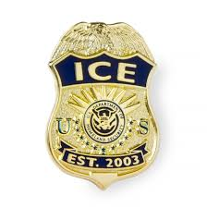
Questions or Comments ??
Written by ICE 287 (g) Program Manager -Tom McCabe and
HCSO 287 (g) Unit Commander – Lieutenant Yvonne Chester

